Slide 1
Plants and nutrients
Figures from textbooks unless otherwise noted

Slide 2
What essential elements do plants use?

Slide 3
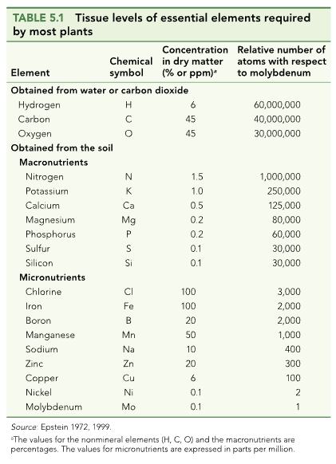

Slide 4
What do they use them for?

Slide 5
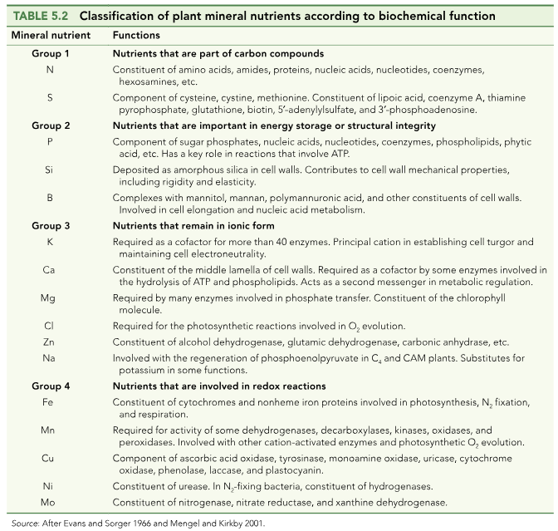

Slide 6
How do nutrients get into the soil?

Slide 7
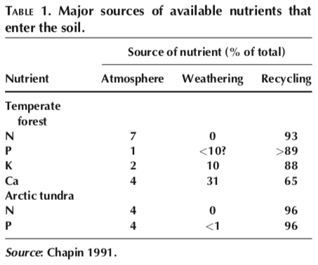

Slide 10
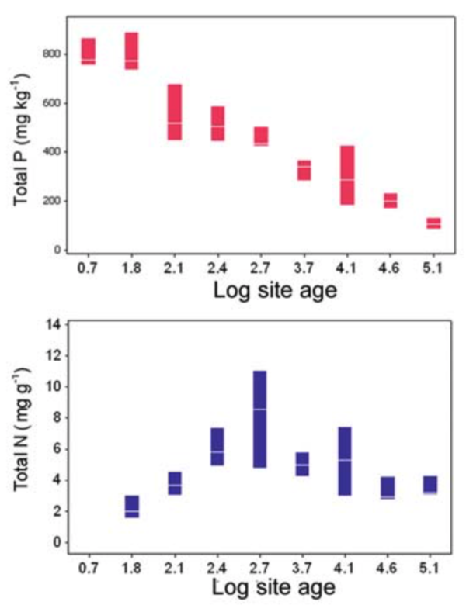
What could explain these trends?

Slide 11
Nutrition impacts: NPP

Slide 12
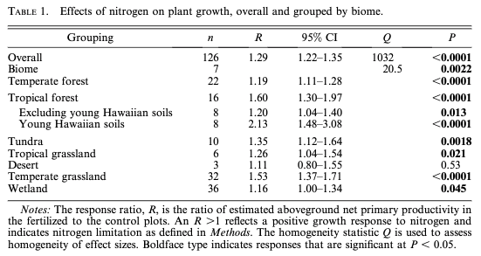
N addition increases NPP by 29% (Lebauer and Treseder, 2008)

Slide 13
N addition increases NPP by 29% (Lebauer and Treseder, 2008)
What could explain this effect?

Slide 14
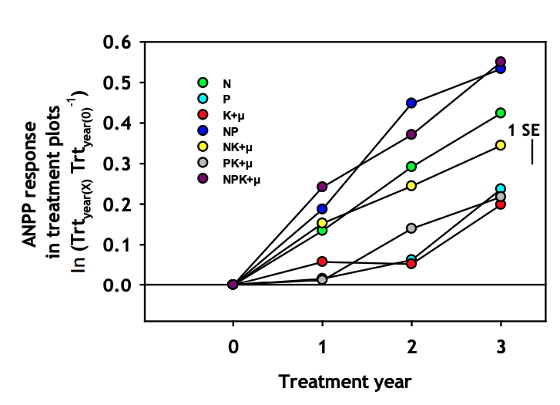
Biomass can be limited by multiple nutrients
Fay et al. (2015)

Slide 15
Nutrition impacts: leaf physiology

Slide 16
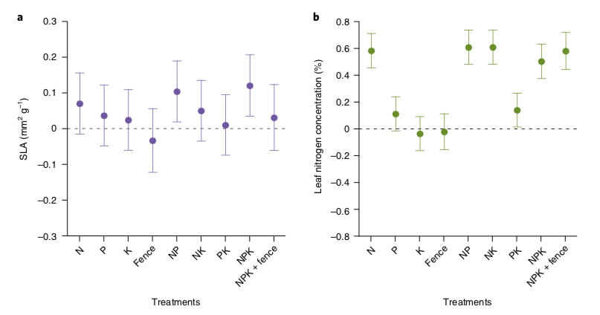
Leaves are basically the same shape, but get packed with more N
Firn et al. (2019)

Slide 17
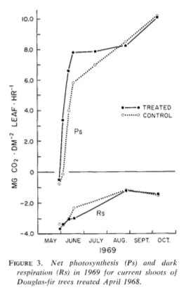
Not necessarily doing more photosynthesis though…
Brix (1971)

Slide 18
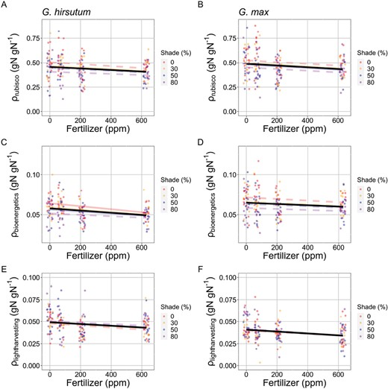
The relative amount of N used for photosynthesis is reduced with added N
Waring et al. (2023)

Slide 19
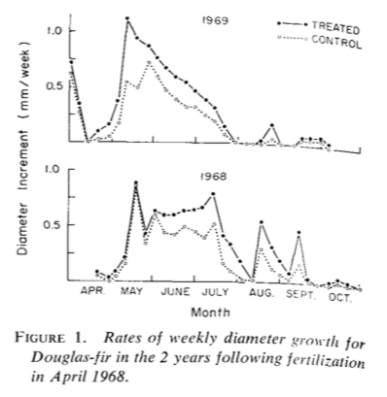
But plants are growing!
Brix (1971)

Slide 20
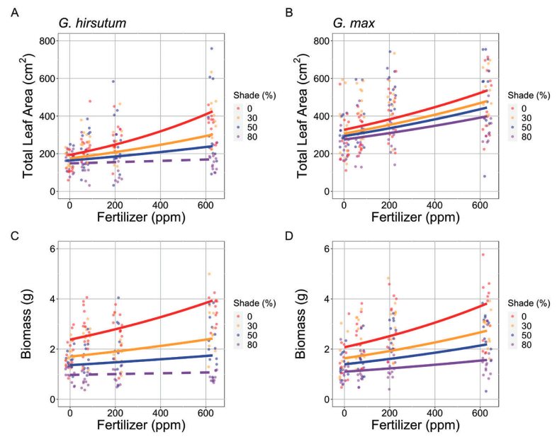
Waring et al. (2023)

Slide 21
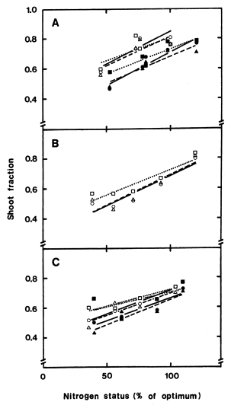
More leaves and shoots are produced at the expense of roots
Ingested et al. (1991)

Slide 22
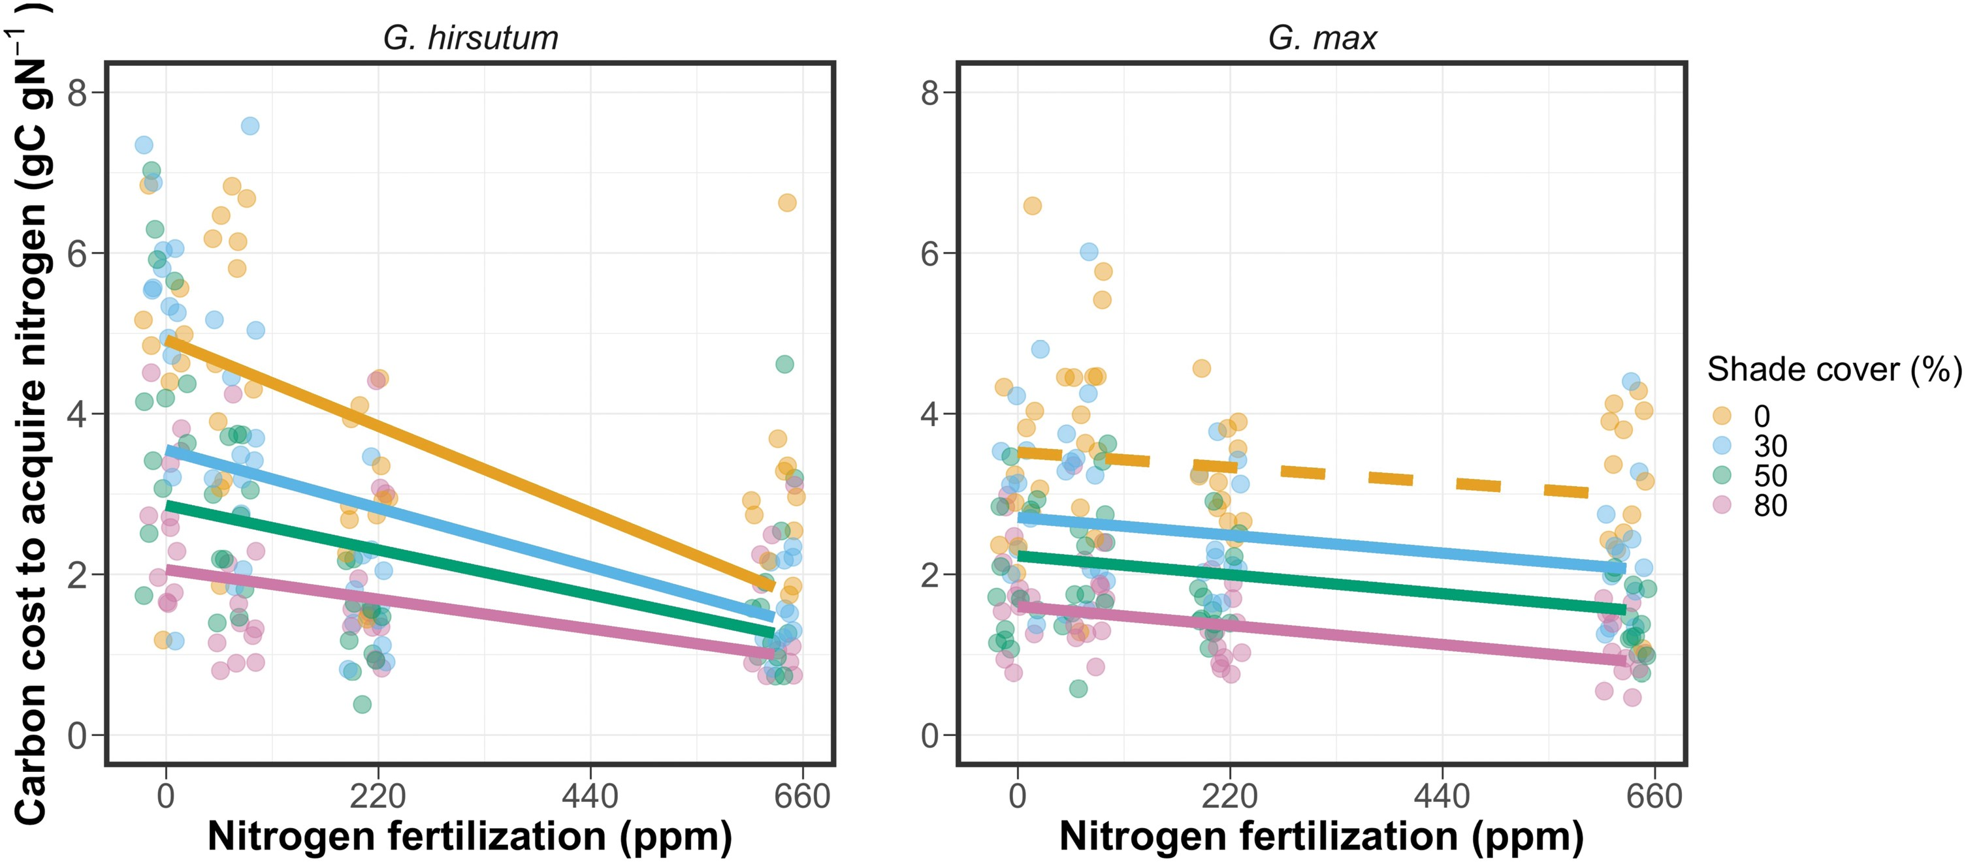
Because it is less costly for the plant to get nutrients
Perkowski et al. (2021)

Slide 23
Nutrition effects on physiological processes
Growth: increases
Storage: increases
Photosynthesis: not heavily impacted
Allocation: shift to aboveground

Slide 24
Nutrition effects on physiological processes
Growth: increases
Storage: increases
Photosynthesis: not heavily impacted
Allocation: shift to aboveground
Why?

Slide 25
Nutrition effects on physiological processes
Growth: increases
Storage: increases
Photosynthesis: not heavily impacted
Allocation: shift to aboveground
What might influence this?

Slide 26
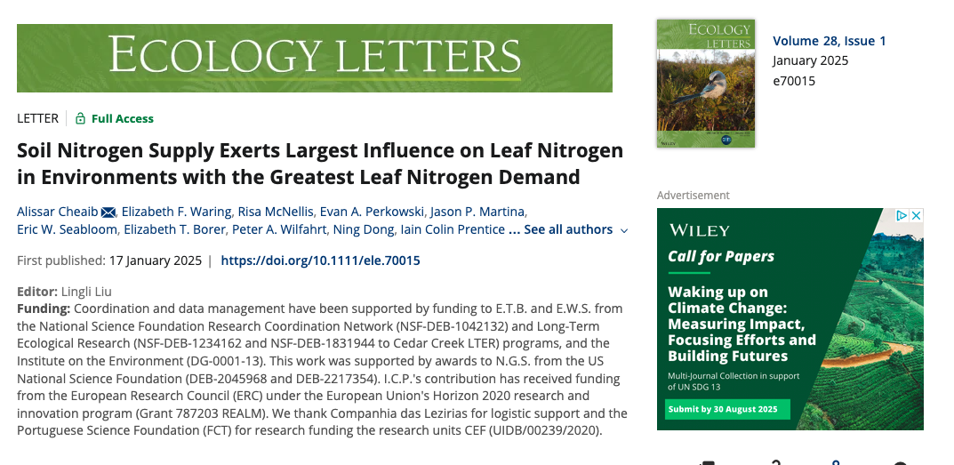

Slide 27
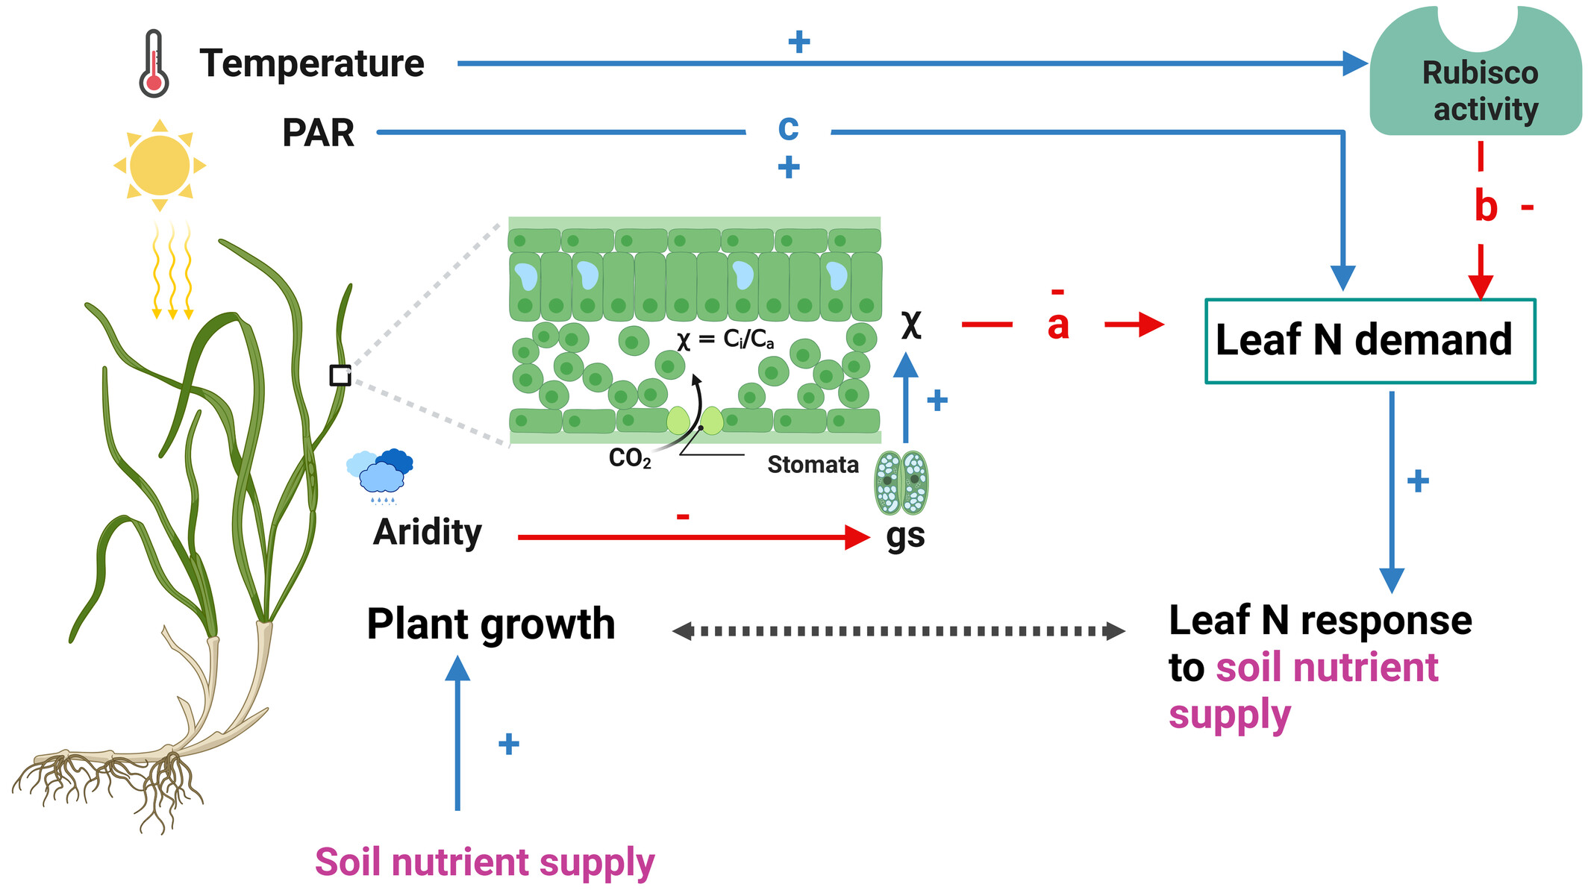
Cheaib et al. (2025)

Slide 28
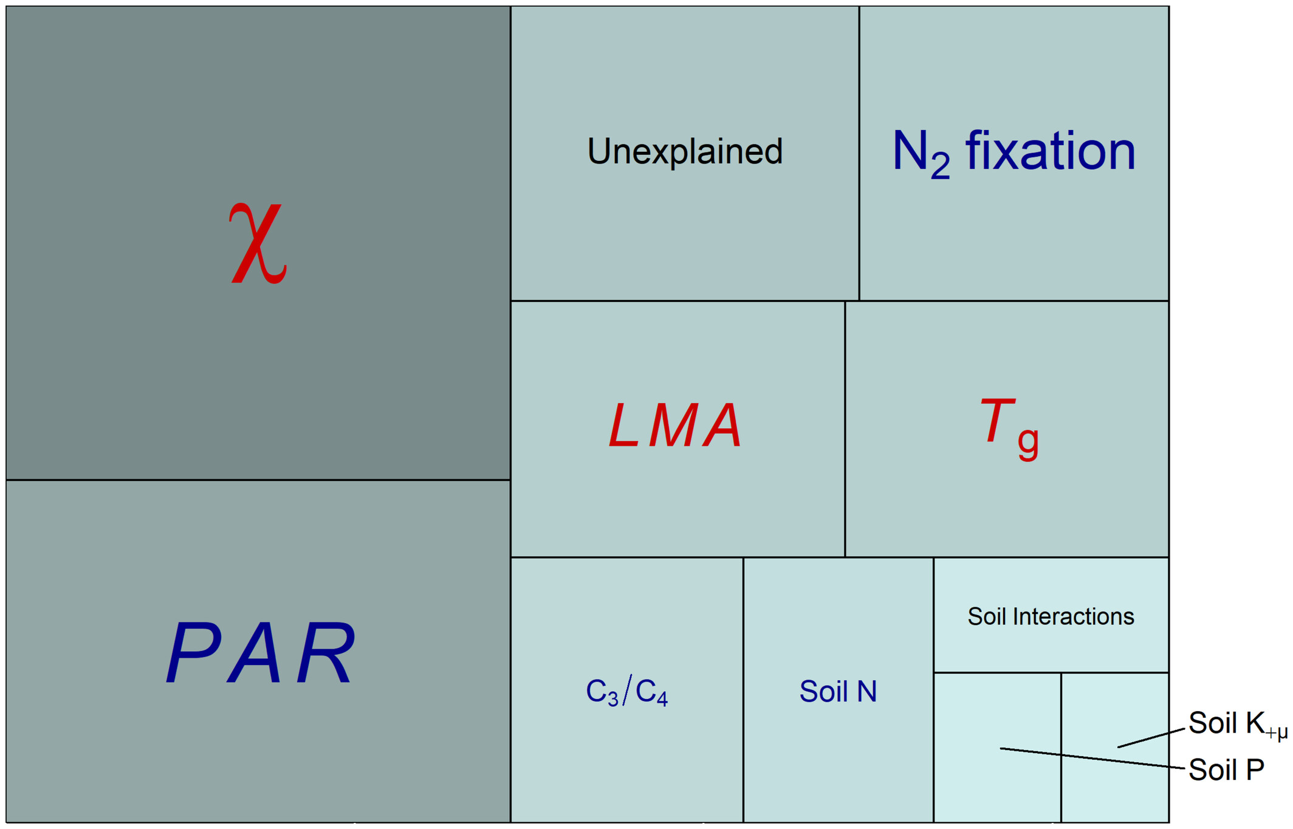
Cheaib et al. (2025)

Slide 29
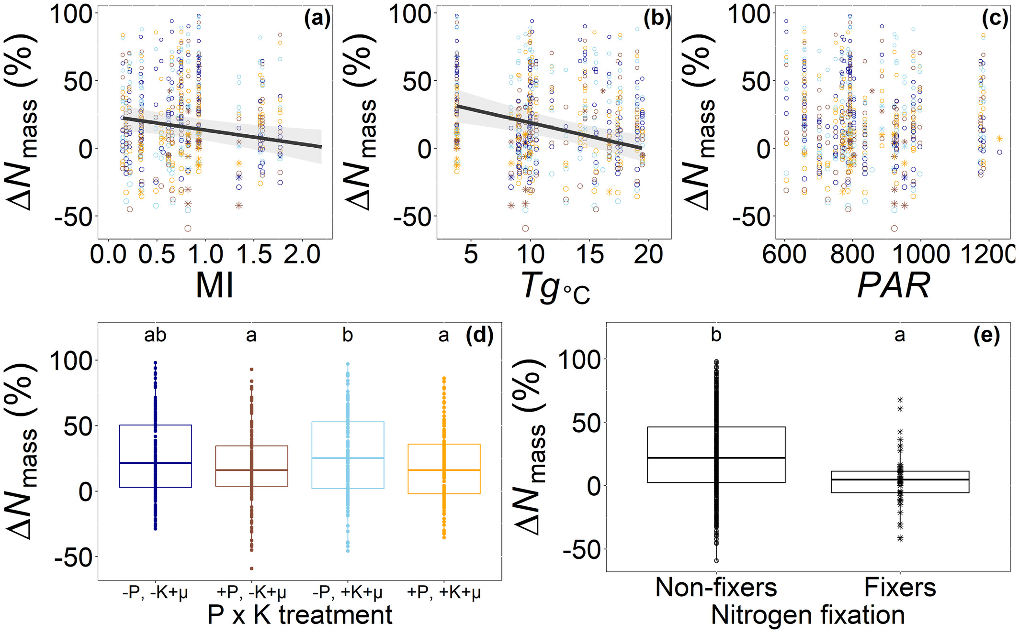
Cheaib et al. (2025)

Slide 30
Cheaib et al. (2025)

Slide 31
Nutrition impacts: Diversity

Slide 32
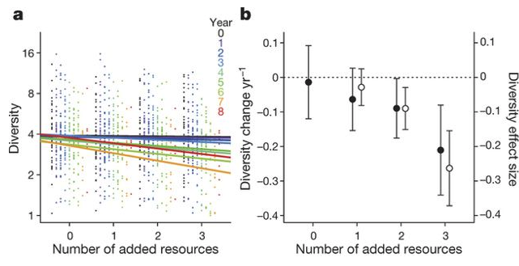
Why would adding nutrients reduce diversity?
Harpole et al. (2016)

Slide 33
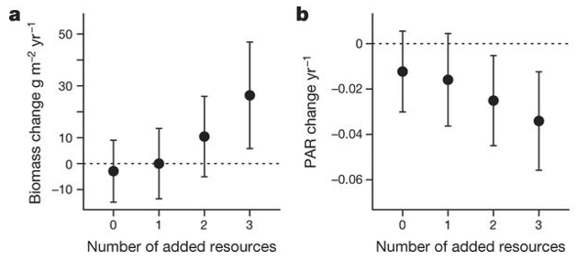
A shift in the importance of other limitations!
Harpole et al. (2016)

Slide 34
Competition example: tallgrass prairie

Slide 35
Competition example: tallgrass prairie
Wildflowers
C3
Fast growing
Use a lot of resources (e.g., Nitrogen)
Grasses
C4
Slow growing
Efficient resource use

Slide 36
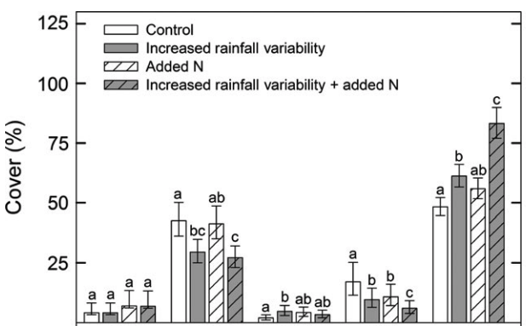
Competition example: tallgrass prairie
Grasses
Wildflowers
Smith et al. (2016)

Slide 37
Competition example: tallgrass prairie
Smith et al. (2016)

Slide 38
Tying together global change

Slide 39
The Jasper Ridge Global Change Experiment

Slide 40
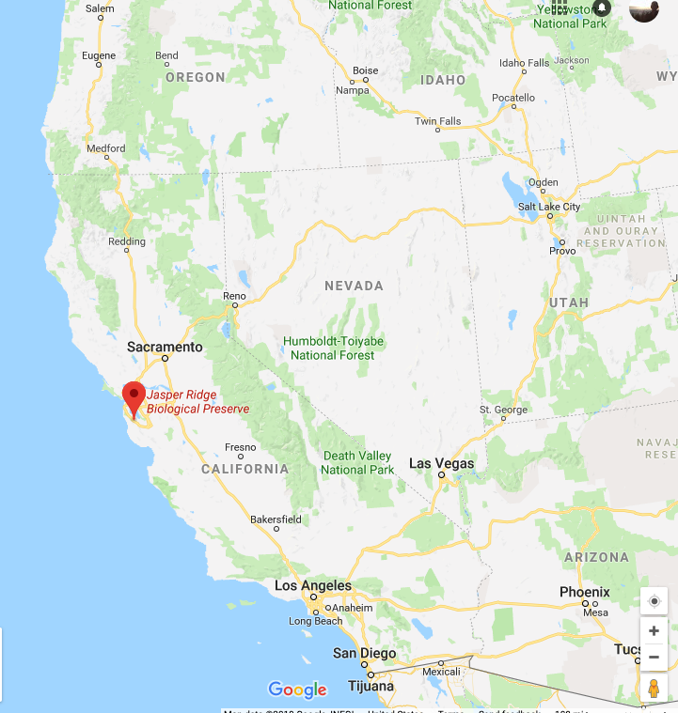
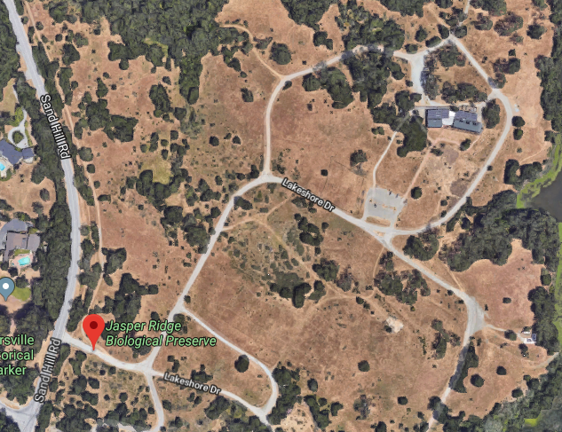
The Jasper Ridge GCE: location
Annual grassland
Mediterranean climate

Slide 41
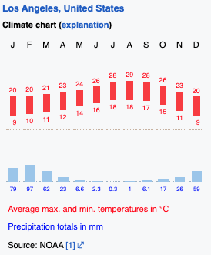
The Jasper Ridge GCE: location
Annual grassland
Mediterranean climate

Slide 42
The Jasper Ridge GCE: treatments
CO2 (FACE)
Ambient
680 ppm
Temperature (heaters)
Ambient
Ambient + 1°C
Precipitation (sprinklers)
Ambient
150% Ambient
Nitrogen (fertilizer)
None
+5 g m⁻² yr⁻¹
*Treatments included all combinations*

Slide 43
The Jasper Ridge GCE: measurements
Root and shoot biomass
Plant community diversity

Slide 44
Assignment: develop a hypothesis for how you would expect the treatments to impact plant biomass and diversity. Use a systems diagram to explain your hypothesis.

Slide 45
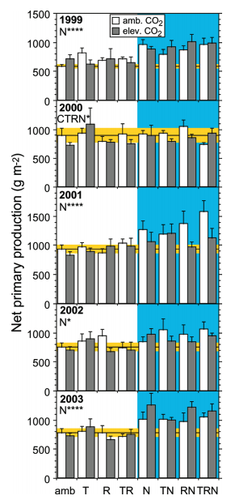
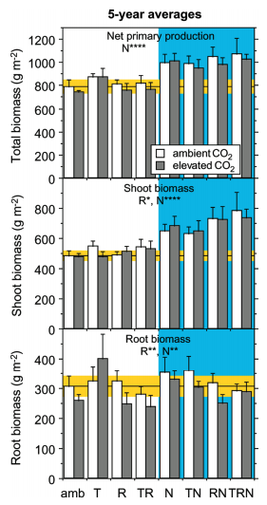
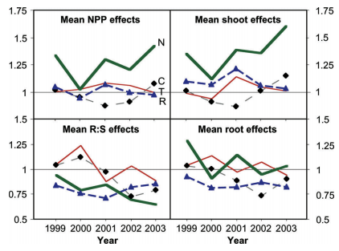
Biomass
Dukes et al. (2005)

Slide 46
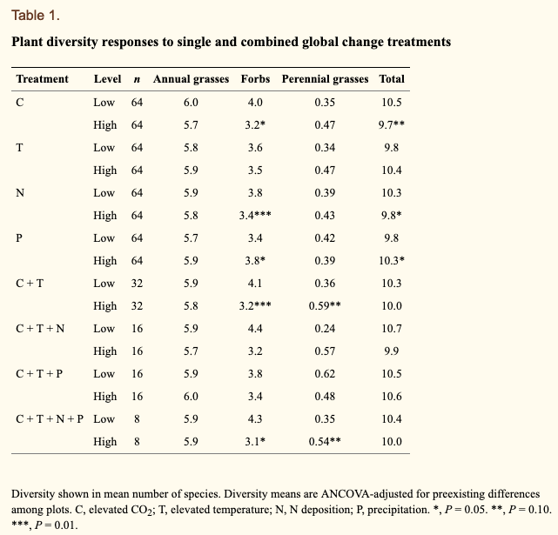
Diversity
Zavaleta et al. (2003)

